Slide 1
CSC141 Introduction to Computer Programming
Teacher:
AHMED MUMTAZ MUSTEHSAN
Lecture - 6

Slide 2
Do not Confuse between C and C++
C is a structured language
C++ is an object oriented language
C++ supports most of the features of structure language
hence you may say C is a subset of C++ (with few exceptions that you need not to worry at this stage)

Slide 3
Declaration, definition and initialization of variables
User input/output functions scanf() and printf()
printf () Function
Format specifier
Field width specifier
Escape sequence
Scanf( ) function
Address operator
For loop
Structure of the for loop
Initialization, test, increment expression
Body of the for loop
Operation of the for loop
Multiple statements in for loop
Multiple initialization in a for loop

Slide 4
Defining and Declaring variables
A variable declaration only specifies the name and type of the variable without allocating memory to it
Declarations are important in multi file programs where a variable defined in one file must be referred to in a second file.
Variable definition on the other hand specifies the name and type of the variable and also sets aside memory for it. When a data is assigned first time to the variable it is defined.
(We will discuss it in detail when study functions)

Slide 5
Initializing variables
Examples
int num=2;
int char=‘d’,
float length=34.5677;
By initializing a variable we provide:
Declaration of variable
Definition of a variable
Initial value loaded in the variable

Slide 6
User Input and output functions
The printf() function is used to display output on the screen
The scanf() function is used to read input from the keyboard
printf() and scanf() both are defined in stdio.h called header file which we include using:
# include <stdio.h>

Slide 7
The printf() function
Printf() is a function like main()
It caused the string written within the quotes “ ” inside printf() function on the screen
The string which is phrase in quotes is the function argument passed to printf()
“Hello World” is a string of characters. C compiler recognizes a string when it is enclosed within quotes.

Slide 8
The definition of printf() and scanf() functions
We have called the function printf() but have not defined it anywhere
The declaration is done in the header file called stdio.h
Its definition is is provided in a standard Library which we will study later on.
The linker links our program with the ***.lib file at the time of linking. This happens for all C library functions
Remember the name of a function is like variable name also called an identifier.

Slide 9
Exploring the printf() function
Printing numbers (integers)
void main (void)
{
printf (“Printing number: %d”, 10);
}
Here printf took two arguments:
Printing number --- argument 1
10 ( what is that ? )--- argument 2
what is %d ---- Format specifier

Slide 10
Format Specifiers
Tells the compiler where to put the value in string and what format to use for printing the value
%d tells the compiler to print 10 as a decimal integer
Why not write 10 directly inside the string?
Possible !! However, to give printf() more capability of handling different values, we use format specifiers and variables

Slide 11
Different Format Specifiers
Format specifiers used for
%c single character
%s string
%d signed decimal integer
%f floating point (decimal notation)
%e exponential notation
%g floating point (%f or %e whichever is shorter)
%u unsigned decimal integer
%x unsigned hexadecimal
%o unsigned octal integer
l prefix used with %d, %u, %x %o
to specify long integer e.g. %ld

Slide 12
Field width Specifiers
Format specifier: %(-)w.nf
f is a format specifier used for float data type
e.g %f
.n means number of digits after decimal point
e.g %.2f 27.25 & %.3f means 27.250
The digit (w) preceding the decimal point specifies the amount of space that number will use to get displayed:
e.g printf (“Age is % 2d” 33); 33
printf (“Age is % 4d” 33); - - 33
printf (“Age is % 6d” 33); - - - - 33

Slide 13
Field width Specifiers
void main (void)
{
printf(“8.1f %8.1f %8.1f\n”, 3.0, 12.5, 523.3);
printf(“8.1f %8.1f %8.1f\n”, 300.0, 1200.5, 5300.3);
}
3.0 12.5 ‘ ‘523.3
300.0 ‘ ‘1200.5 ‘ ‘5300.3

Slide 14
Field width Specifiers
void main (void)
{
printf(“-8.1f %-8.1f %-8.1f\n”, 3.0, 12.5, 523.3);
printf(“-8.1f %-8.1f %-8.1f\n”, 300.0, 1200.5, 5300.3);
}
3.0’ ‘12.5 ‘ ‘ 523.3
300.0 ‘ ‘ 1200.5 ‘ ‘5300.3

Slide 15
Escape Sequence
\n prints carriage return and linefeed combination
\t tab
\b backspace
\r carriage return
\’ single quote
\ “ double quote
\ \ backslash

Slide 16
Printing Strings using printf () function
void main (void)
{
printf(“%s is %d years old”,”Ahmed”,22);
}

Slide 17
Printing characters using printf () function
void main (void)
{
printf(“%c is pronounced as %s”, ’j’, ”jay”);
}
Single quotes are for character whereas the %c is format specifier
Double quotes are for strings whereas the %s is format specifier

Slide 18
Scanf() function
void main (void)
{
int userAge;
printf(“Enter the the age: ”);
scanf(“ %d”, &userAge);
}
scanf() reads in data and stores it in one or more variables.
The first argument (the control string), contains a series of placeholders
The remaining arguments to scanf() is a variable name proceed with & sign called address operator

Slide 19
scanf() can read data into multiple variables
int a, b,
float c;
char d;
scanf(“ %d %d %f %c” , &a, &b, &c, &d);
Input is stored in these variables. Each variable name is preceded by & , &a means “the memory address associated with variable a”
It uses any whitespace (space, newline or tab) character to delimit inputs in case of multiple inputs
Format specifiers are like the ones that printf() uses
e.g. %d = int, %f = float, %c = char, etc.

Slide 20
Comments
/* --------------------*/ multiline comments
// single line comments

Slide 21
Loops
Computer has the ability to perform set of instructions repeatedly
This repetitive operation is performed using loops
It involves repeating some portion of the program either a specified number of times or until a particular condition is being satisfied

Slide 22
Loops
There are three types of loops in C
For loop
While loop
Do while loop
For loop is the most popular looping instruction used by the programmers

Slide 23
For loop
It specifies three things about a loop in one line
Setting a loop counter to an initial value
Testing the loop counter to determine whether its value has reached the number of desired repetitions
Increasing the value of loop counter each time the program segment within the loop has been executed

Slide 24
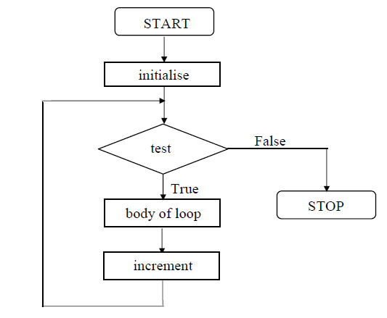
Flowchart of the for loop

Slide 25
For loop … continued
The general form of for loop is:
for (initialize counter; test counter; increment/decrement counter)
{
Do this;
And this;
And this;
}

Slide 26
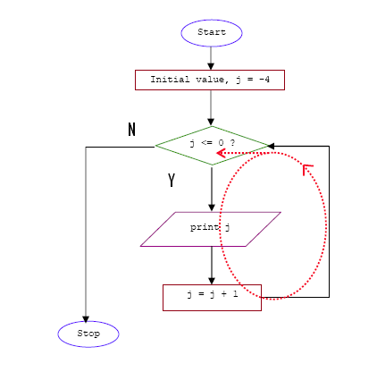
Example: Print an integer number from -4 to 0

Slide 27
Sample Program
void main()
{
int j;
for(j = -4; j <= 0 ; j = j + 1)
printf("%d\n", j);
}

Slide 28
print numbers from 1 to 10
void main( )
{
int i ;
for ( i = 1 ; i <= 10 ; i = i + 1 )
printf ( "%d\n", i ) ;
}
Instead of i = i + 1, the statements i++ or i += 1 can also be used.

Slide 29
Print numbers from 1 to 10
void main( )
{
int i ;
for ( i = 1 ; i <= 10 ; )
{
printf ( "%d\n", i ) ;
i = i + 1 ;
}
}
Here, the increment is done within the body of the for loop and not in the for statement. Note that despite of this the semicolon after the condition is necessary.
Notes:
Remove increment and see if it works gets compiled gets executed
Ans: infinite display of 1

Slide 30
print numbers from 1 to 10
void main( )
{
int i = 1 ;
for ( ; i <= 10 ; i = i + 1 )
printf ( "%d\n", i ) ;
}
Here the initialisation is done in the declaration statement itself, but still the semicolon before the condition is necessary.

Slide 31
print numbers from 1 to 10
void main( )
{
int i = 1 ;
for ( ; i <= 10 ; )
{
printf ( "%d\n", i ) ;
i = i + 1 ;
}
}
Here, neither the initialisation, nor the incrementation is done in the for statement, but still the two semicolons are necessary.

Slide 32
print numbers from 1 to 10
void main( )
{
int i ;
for ( i = 0 ; i++ < 10 ; )
printf ( "%d\n", i ) ;
}
Here, the comparison as well as the incrementation is done through the same statement, i++ < 10. Since the ++ operator comes after i firstly comparison is done, followed by increment. Note that it is necessary to initialize i to 0.
Notes:
Condition works or not
Ans: yes
Printed numbers upto 9 or 10
Ans: upto 10

Slide 33
print numbers from 1 to 10
void main( )
{
int i ;
for ( i = 0 ; ++i <= 10 ; )
printf ( "%d\n", i ) ;
}
Here, both, the comparison and the incrementation is done through the same statement, ++i <= 10. Since ++ precedes i firstly incrementation is done, followed by comparison. Note that it is necessary to initialize i to 0.

Slide 34
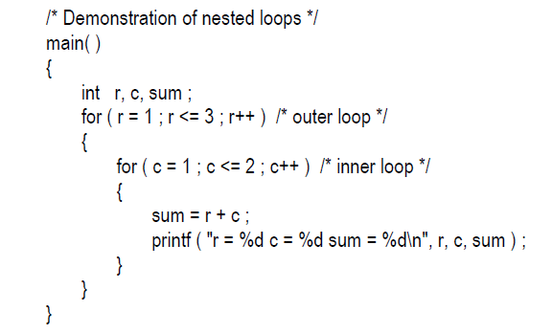
Nesting of Loops
r = 1 c = 1 sum = 2
r = 1 c = 2 sum = 3
r = 2 c = 1 sum = 3
r = 2 c = 2 sum = 4
r = 3 c = 1 sum = 4
r = 3 c = 2 sum = 5
void

Slide 35
Multiple Initialisations in the for Loop
The initialisation expression of the for loop can contain more than one statement separated by a comma. For example,
for ( i = 1, j = 2 ; j <= 10 ; j++ )
Multiple statements can also be used in the incrementation expression of for loop; i.e., you can increment (or decrement) two or more variables at the same time.
However, only one expression is allowed in the test expression. This expression may contain several conditions linked together using logical operators.

Slide 36
Solution to the last Practice Quiz
Question -1: Solve the following expressions
a). 3 - 8 / 4 b). 3 * 4 + 18 / 2
void main( )
{
printf ( “The result of the expression is %d \n",
3 - 8 / 4) ;
printf ( “The result of the expression is %d \n",
(3 * 4 + 18 / 2));
}

Slide 37
Solution to the last Practice Quiz
Question - 2: If a=2, b=4, c=6, d=8, then what will be the result of the following expression?
x = a * b + c * d / 4;
void main( )
{
int a =2, b=4, c=6, d=8;
printf ( “The result of the expression is %d \n",
x = a * b + c * d / 4) ;
}

